Slide 1
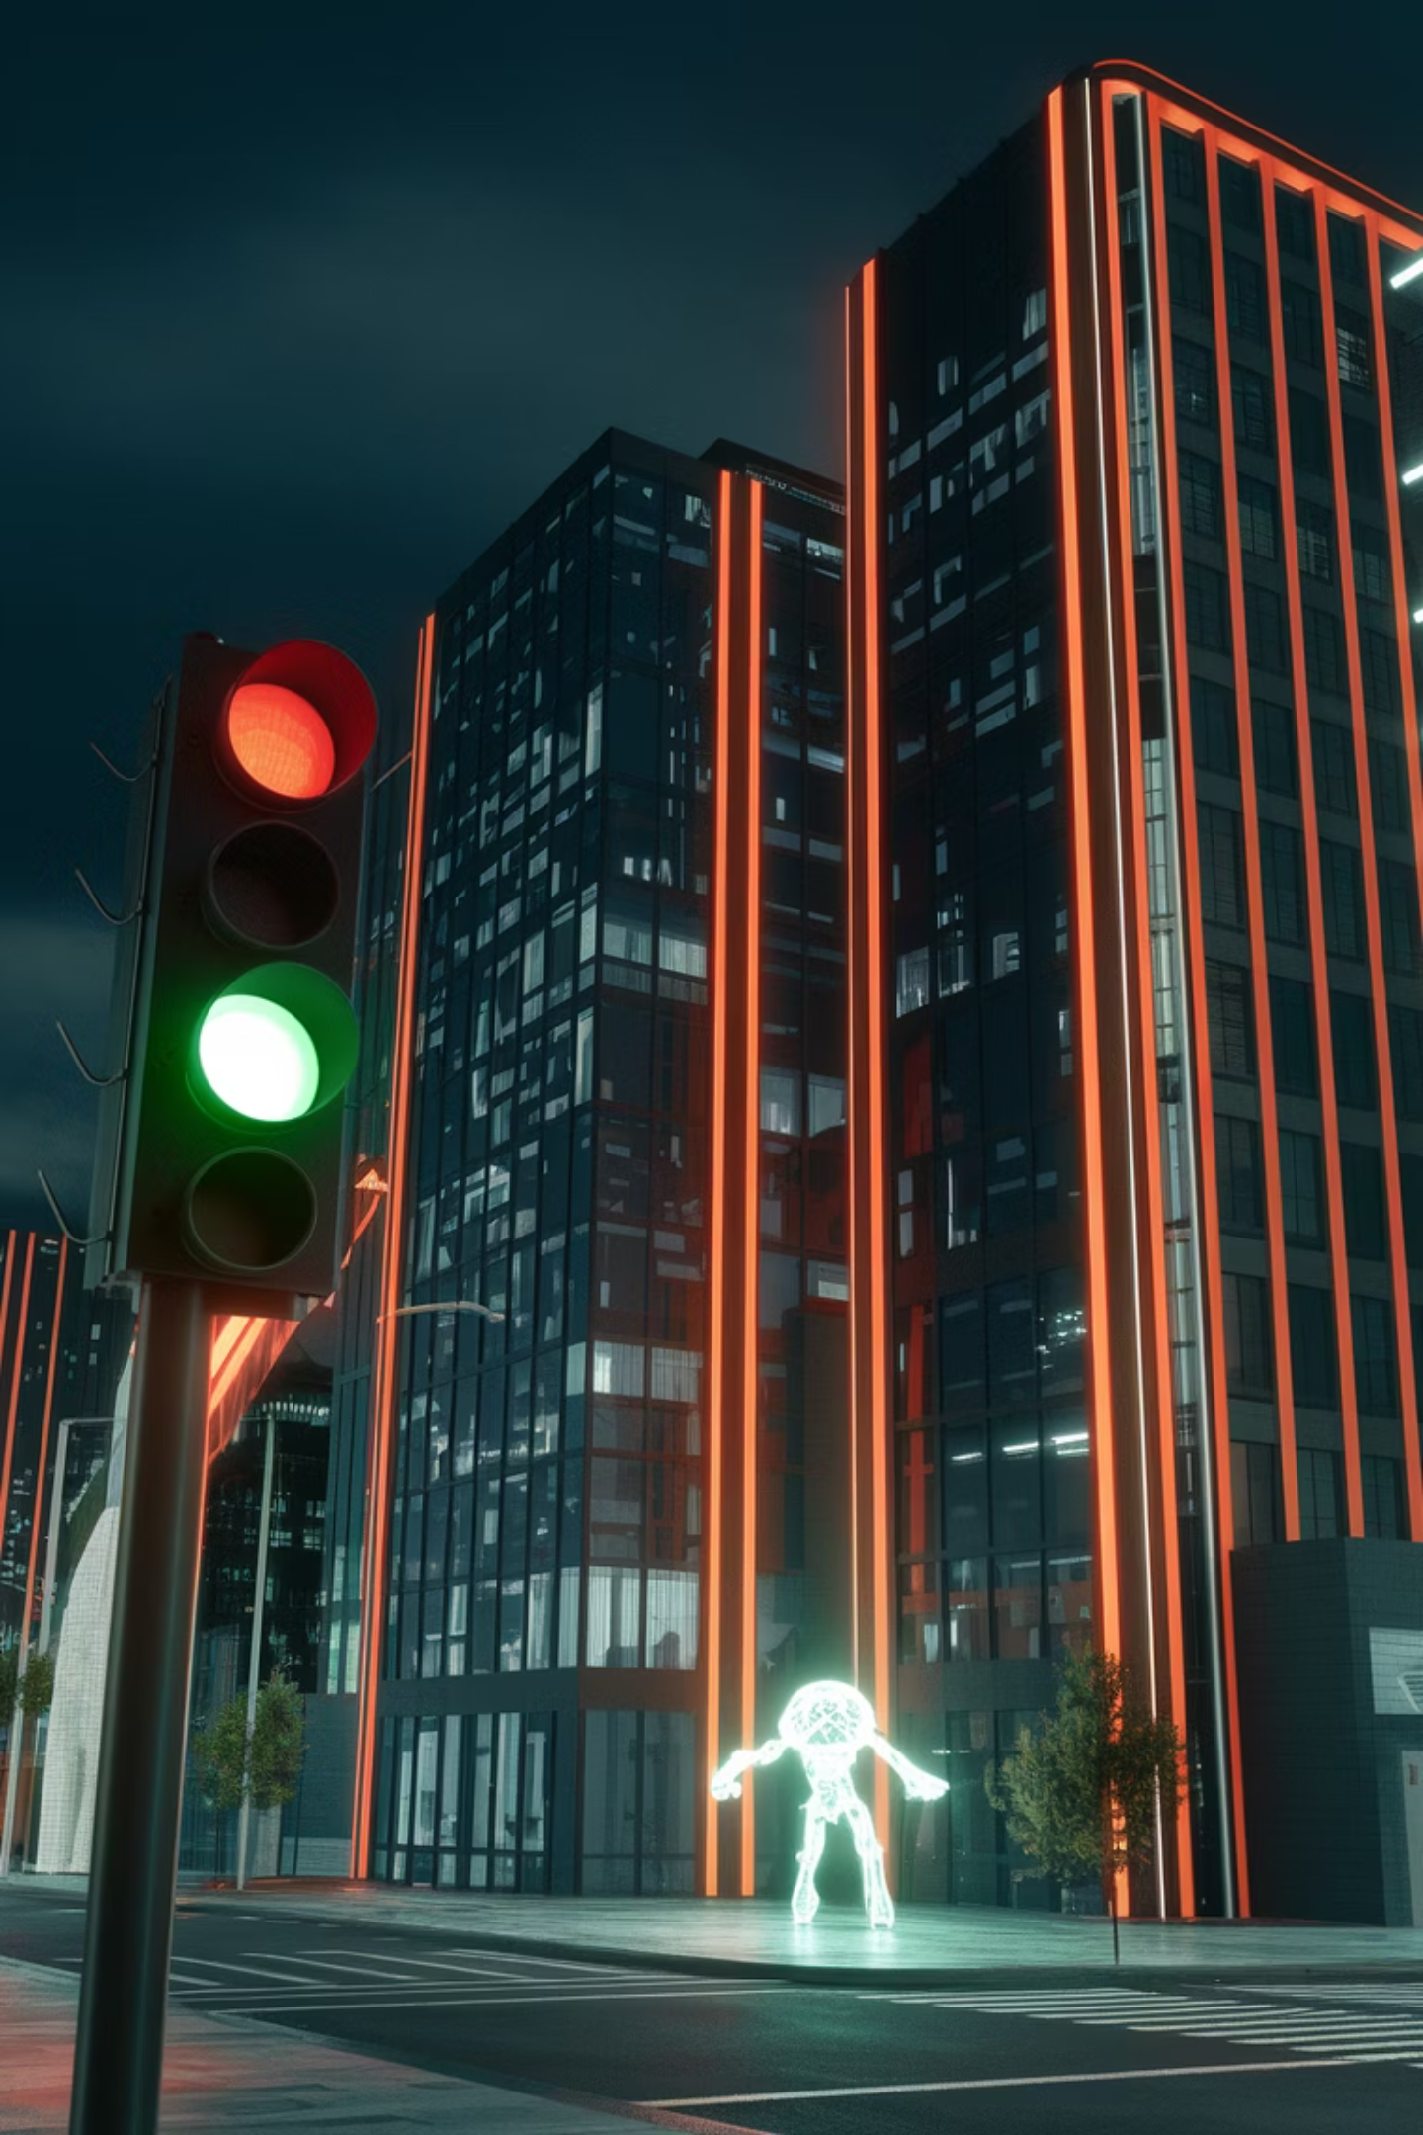
Changing Traffic Lights with Flipper: Real or Fake?
Cybersecurity Club 2025
By: Dennis Freyman

Slide 2
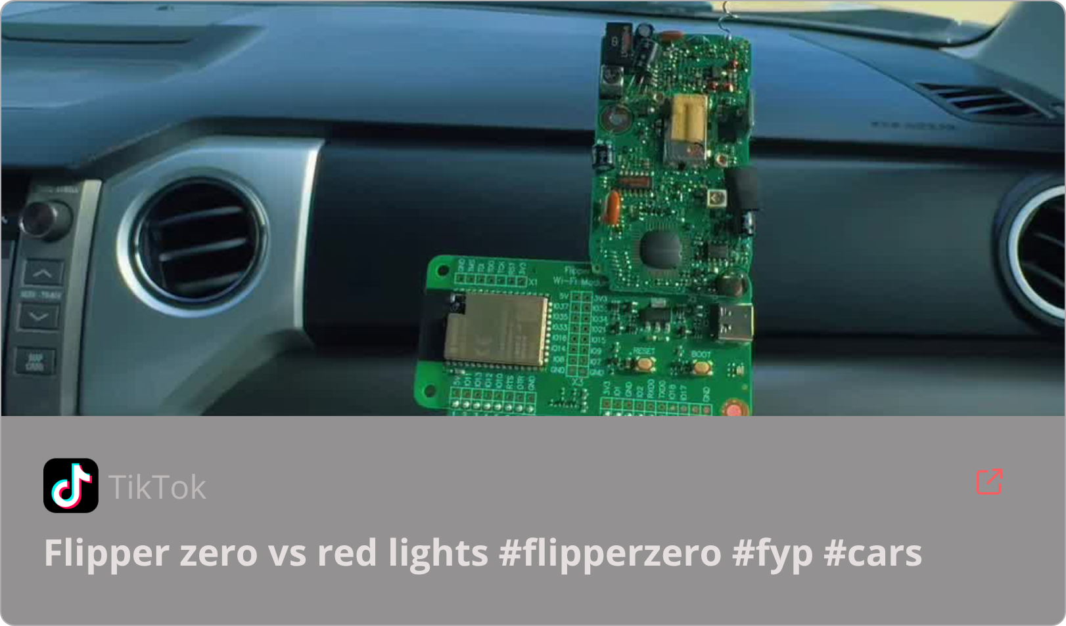

Introduction
What is a Flipper Zero?
Can Flipper Zero manipulate traffic lights like in TikTok and YouTube videos?
A Versatile hacking tool designed for testing and experimenting with radio signals, RFID, and infrared.

Slide 3
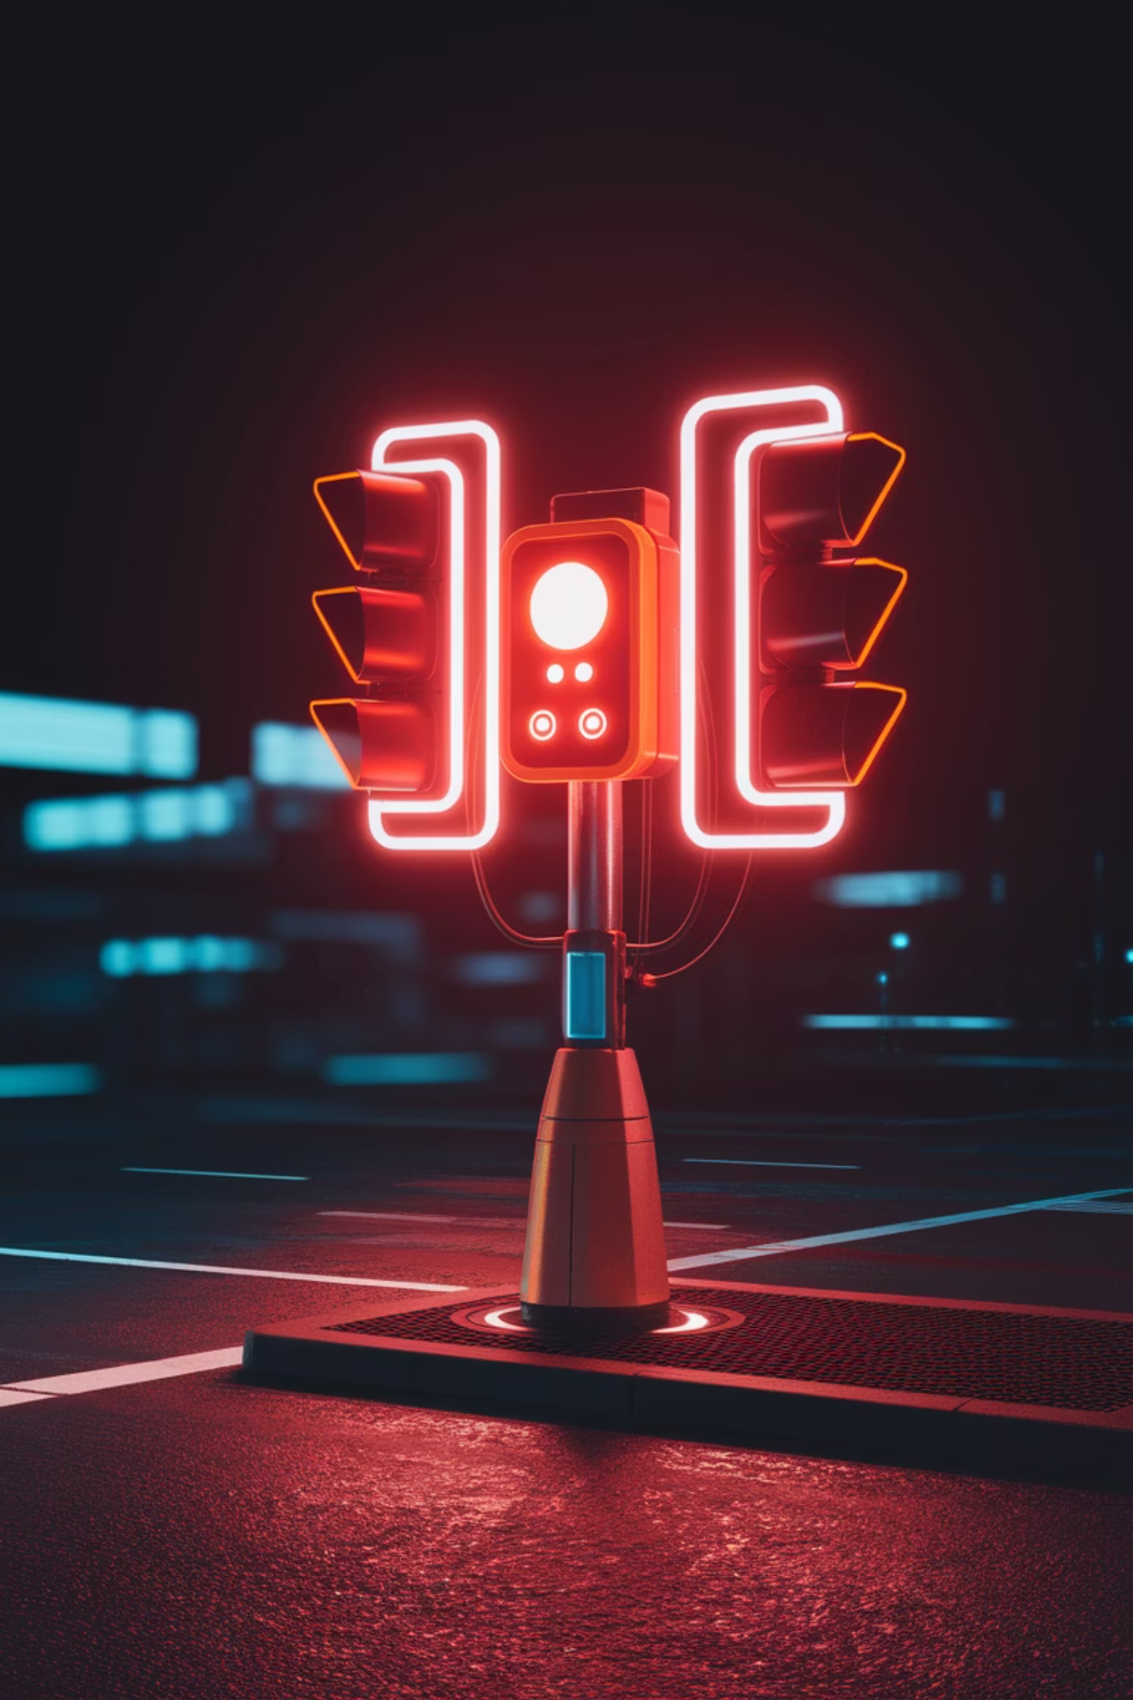
How Do Traffic Lights Work?
2 Main Types of Systems:
Common traffic detection methods:
Centralized systems: Controlled by a traffic management center, often connected by fiber optic or wireless networks.
Inductive loops (sensors embedded in the road to detect cars)
Infrared sensors (used for emergency vehicle preemption or EVP)
Decentralized systems: Operate independently, relying on timers, sensors, and vehicle detection.
Radio signal receivers (used in some cities for EVP and adaptive control)

Slide 4
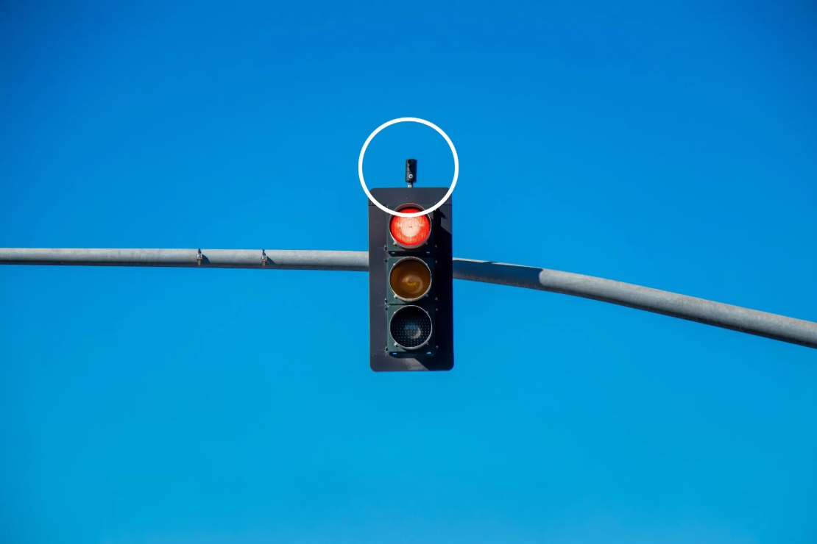
Understanding EVP Systems
EVP
How EVP typically works:
Emergency Vehicle Preemption allows ambulances, fire trucks, and police cars to change traffic lights for emergency response.
Uses infrared signals or radio frequencies to communicate with traffic lights.
Requires a specific, authorized signal sent from emergency vehicles.
This would be the ONLY way to communicate with traffic light systems externally.
Most modern EVP systems are encrypted to prevent unauthorized use.

Slide 5
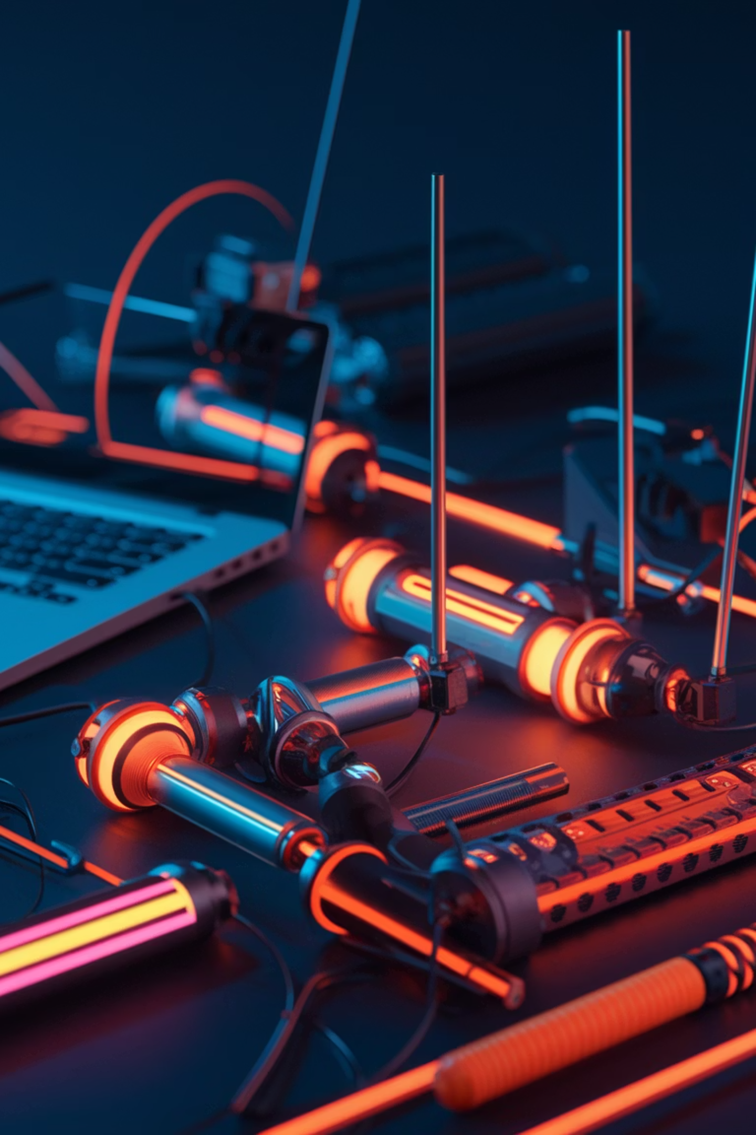


Theory One - Spoofing
Spoofing
Older traffic systems were more vulnerable:
EVP systems use encrypted signals and require authentication tokens or credentials that are difficult to replicate without access to authorized devices or information.
Some used unencrypted IR signals that could theoretically be copied.

Slide 6
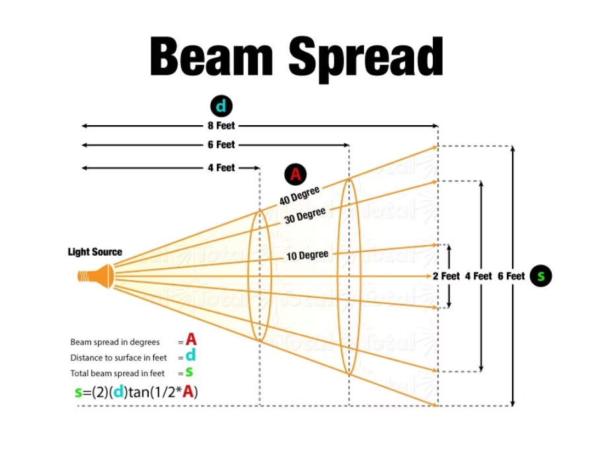
Flipper Zero Specs and Limitations
Infrared Power Output:
Wavelength Mismatch:
Flipper Zero’s built-in infrared LED has a peak power output of around 50mW at best.
Flipper Zero emits at a wavelength of 940nm, whereas many EVP receivers use a range of 850nm-900nm, reducing effectiveness.
Beam Spread: Flipper Zero's IR emitter has a wide beam, whereas EVP signals are typically narrow and highly directional.
Required Power for Traffic Systems: Many EVP receivers require a signal strength of 1W or higher to be effective over long distances.

Slide 7
What is Needed for a Older System in Theory?

Slide 8
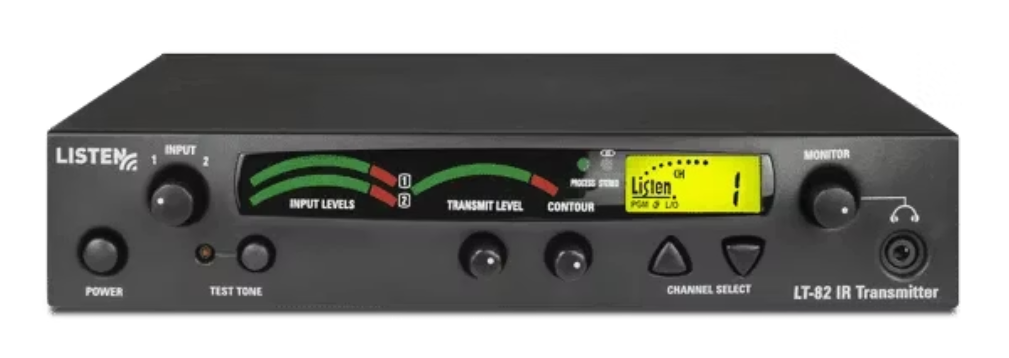
1. A high-powered IR transmitter capable of emitting at 1W or higher.

Slide 9
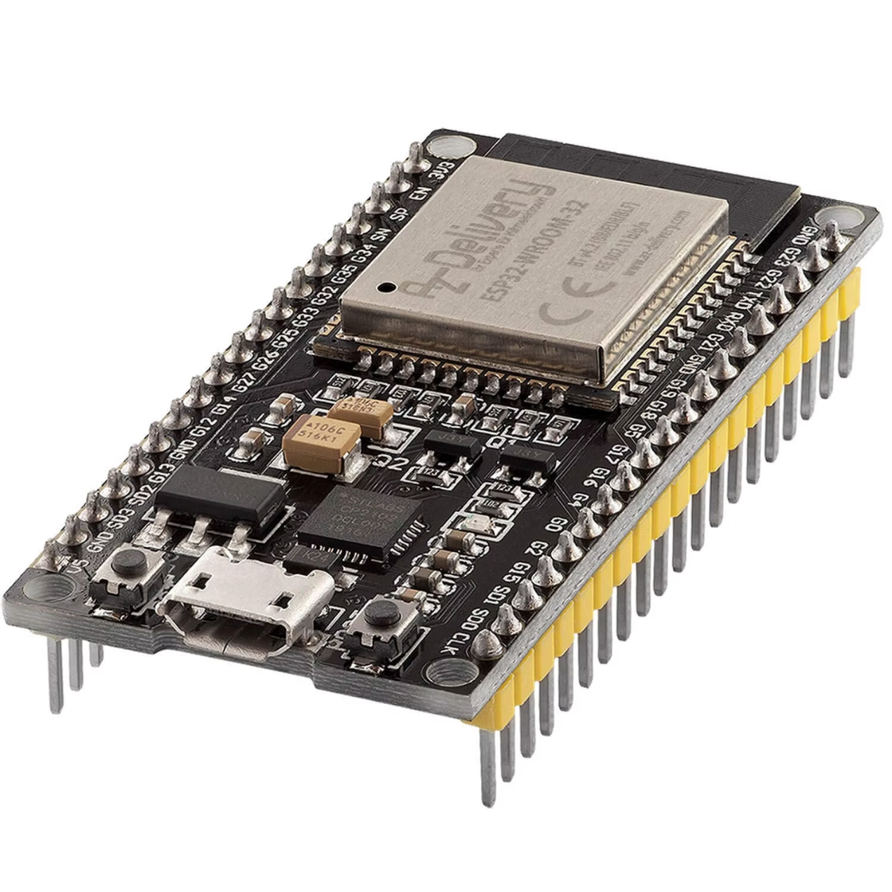
2. A custom-programmed microcontroller (e.g., an ESP32 or Raspberry Pi with an IR LED driver circuit).

Slide 10
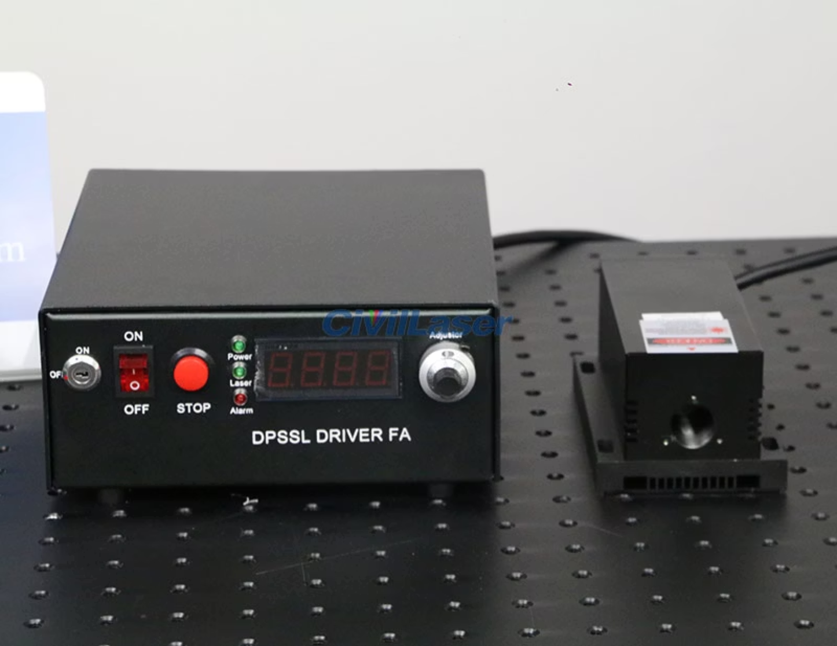
A high-powered IR spotlight (commercially available IR spotlights for CCTV applications could work but require modification).

Slide 11
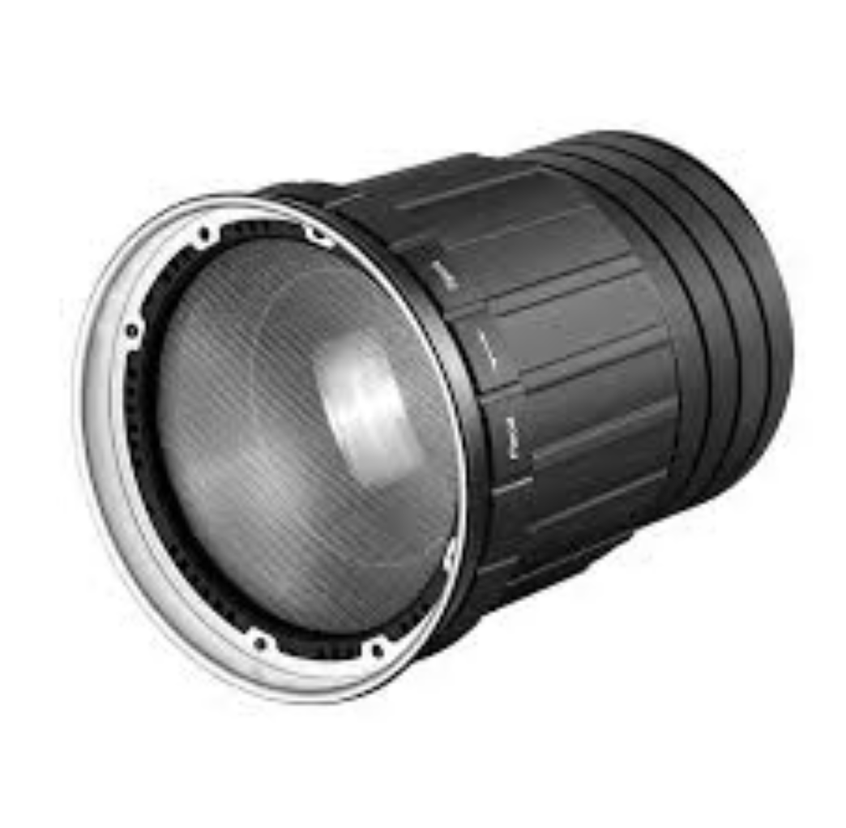
Directional Focusing Lens to ensure the beam remains strong over distances (many EVP receivers are mounted on poles 10-30 feet high).

Slide 12
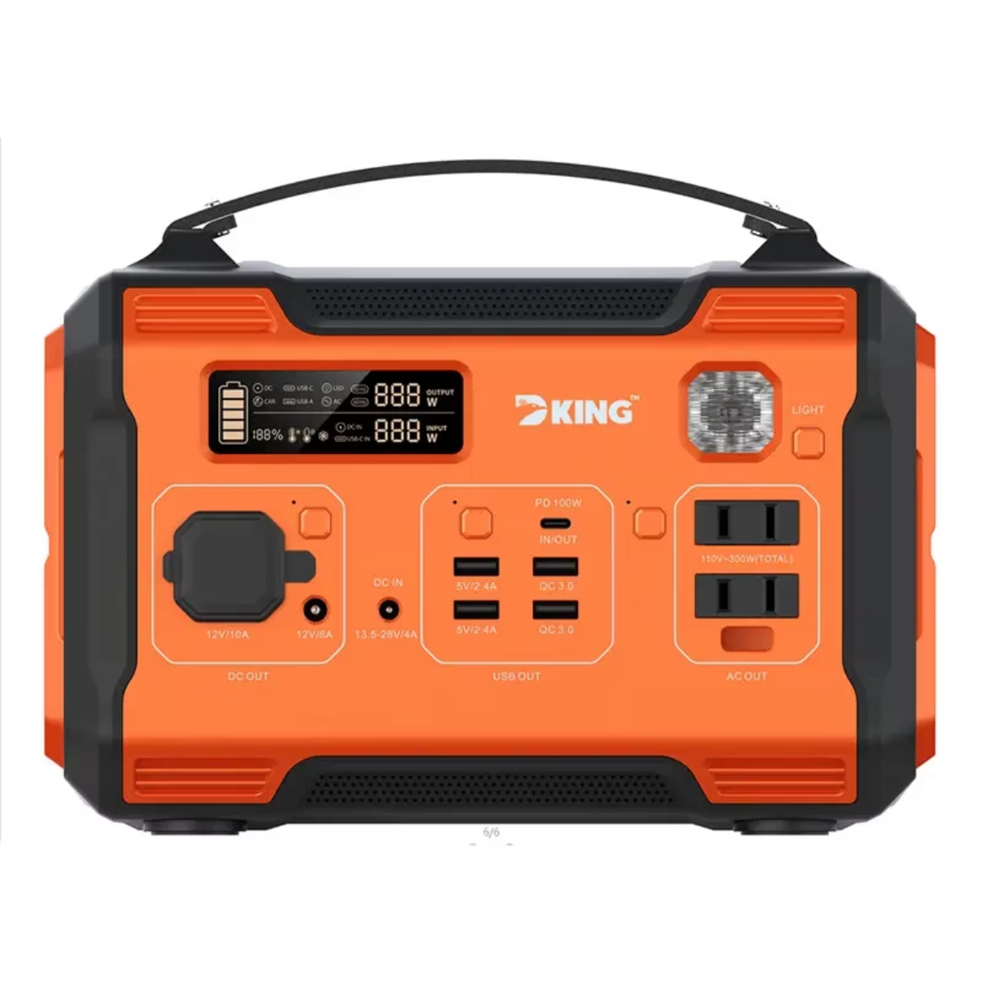
A power supply capable of driving everything (a Flipper runs on a small LiPo battery, which is insufficient).

Slide 13
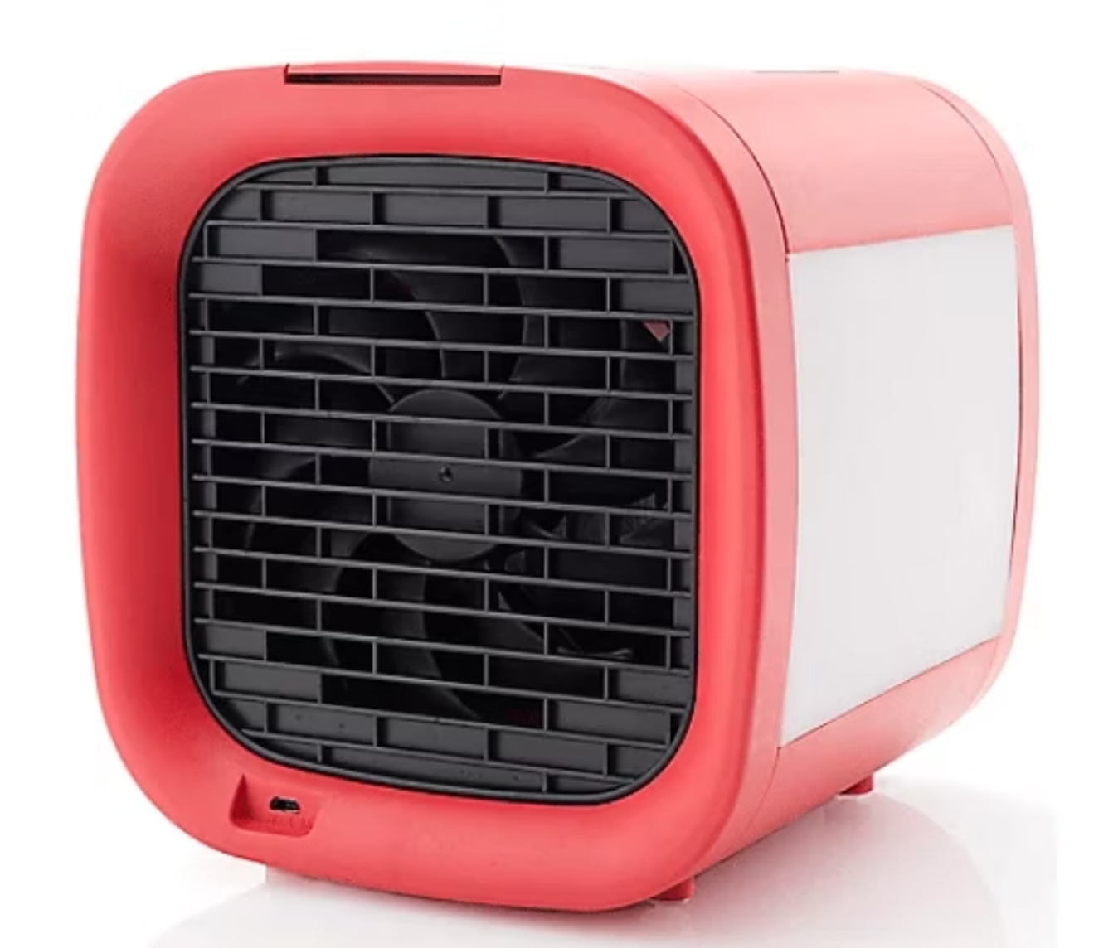
Proper cooling mechanisms (high-power IR LEDs generate a lot of heat and require heatsinks or active cooling).

Slide 14

Specialized knowledge of EVP signal encoding (many modern EVP systems use proprietary encoding, which would require reverse engineering to spoof).

Slide 15
Modern Systems
Modern traffic systems have encryption and authentication that prevent spoofing.
Flipper Zero limitations:
IR range is too short.
Many signals are radio-based or fiber-optic controlled, meaning IR-based EVP systems are no longer widely used.
It cannot properly modulate the required signal.
It does not support the required encryption-breaking capabilities.
Legal risks: Interfering with traffic control systems is a felony.
Even if you had a properly configured 1W IR emitter, you would still need physical access close enough to the receiver.
Signal authentication methods: Many modern EVP systems require a rolling code authentication similar to car key fobs.
Unauthorized signals would be ignored or logged.

Slide 16
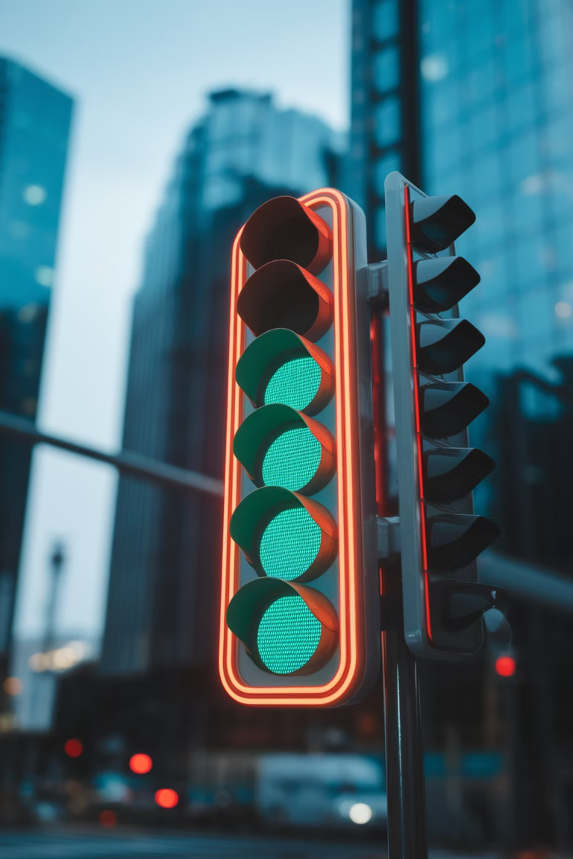




So if its so hard, how do all these fake videos exist?
Editing tricks: Traffic lights changing at natural intervals, then edited to look hacked.
Pre-scheduled light changes: Some systems use timed cycles that can be falsely attributed to Flipper.
No technical details provided: Real EVP hacks would require substantial proof, which no video offers.
Flipper Zero’s own hardware limits: Cannot output the necessary signals.

Slide 17
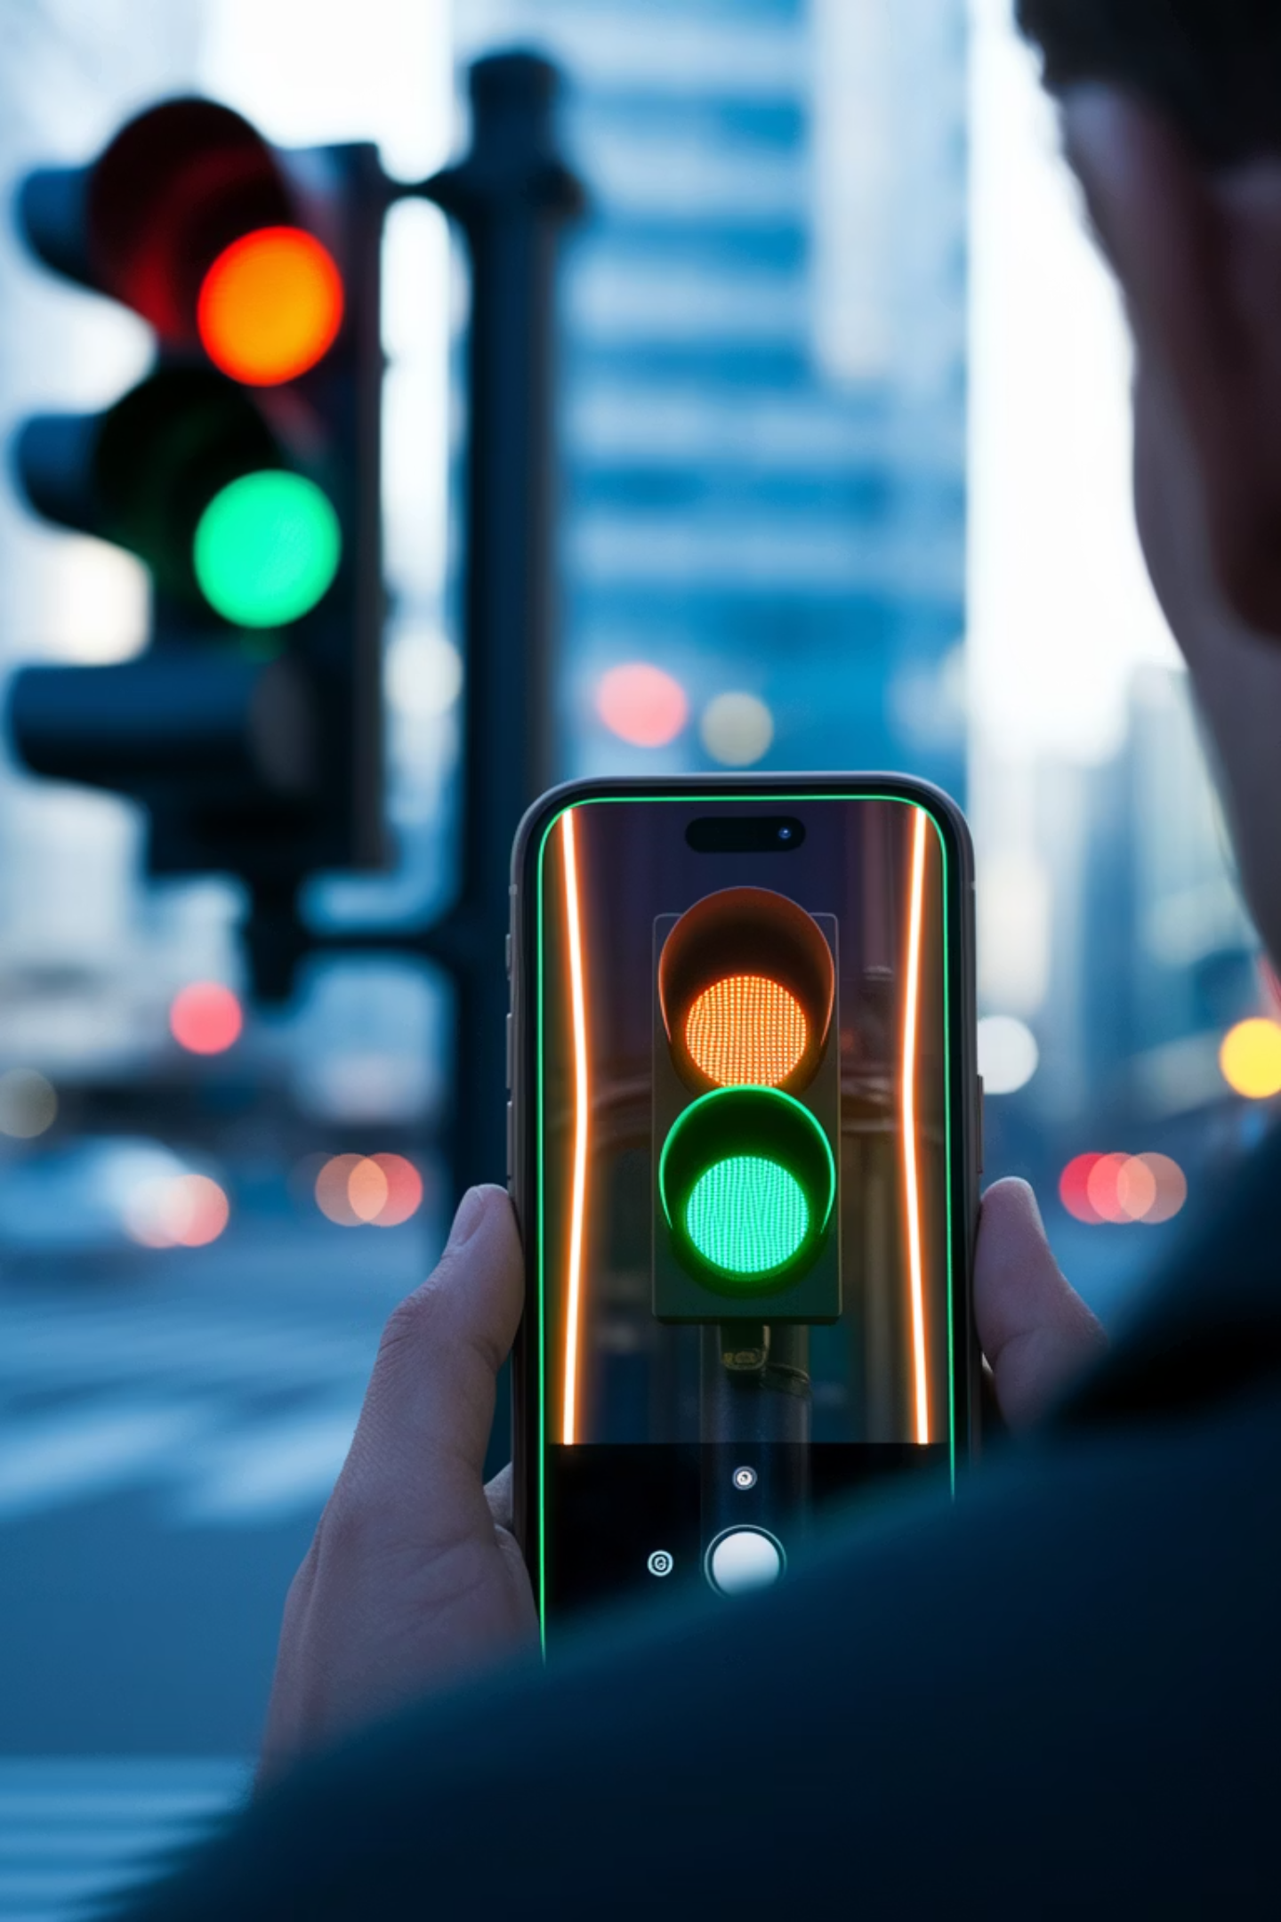
Dont Believe Everything You See on the Internet!
1
2
Misinformation
Misleading Demonstrations
Videos often exaggerate the ease of hacking.
May use pre-programmed devices or fake controllers.
3
Entertainment Value
Focus on shock value and viral content.

Slide 18
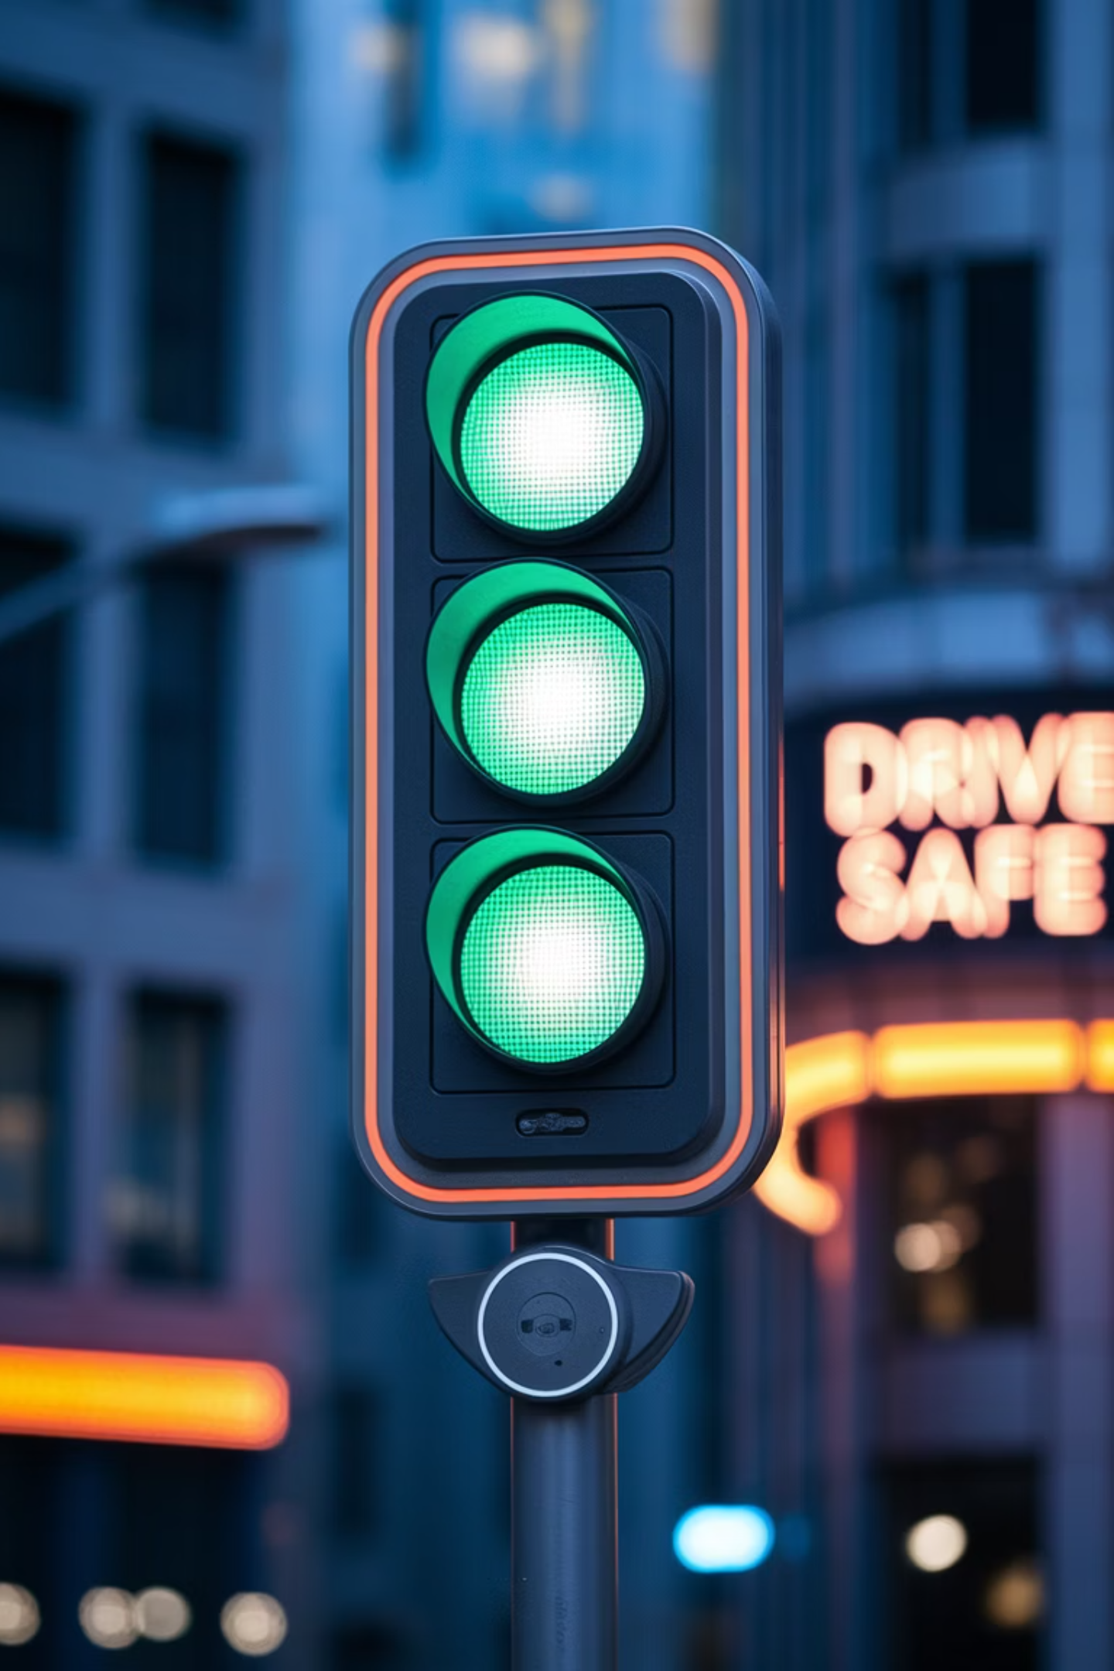
Conclusion
Modern systems? Fake – encryption prevents hacks.
Older systems? Possible, but requires specialized equipment, outdated infrastructure, and precise conditions.
Flipper Zero? Cannot change traffic lights.
Online claims? Almost all are fake or misleading.
To actually perform this, you’d need specialized equipment, a deep understanding of signal encoding, and a massive power source—things far beyond the capabilities of Flipper Zero (you know what else is massive?)

Slide 19

Thank You!

